Slide 1
Hyperparameter Fine-Tuning
Tomas Karpati tc.datascience@gmail.com
054-2002430

Slide 2

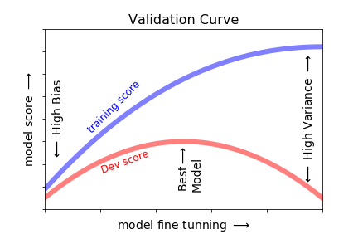
Hyperparameter Fine-Tuning
Flat File
Test
Model
Assessment
Metric
Train/Dev-Validation
Train
Hyper-parameter
Selection
Dev
Best model
Validation
Metric

Slide 3
Hyperparameter Fine-Tuning
How to find the best model?
Gradient descent:
Learning rate
Number of iterations
Adjust for specific model parameters (Hyperparameters)
Use the correct metrics for model validation and model assessment
This process is also known as model fine-tuning

Slide 4
Hyperparameter Fine-Tuning
Logistic regression hyperparameters
Regularization methods
l2 regularization: shrinkage factor = alpha (0.1 to ∞)
l1 regularization: alpha (0.1 to 1)
C: Inverse of regularization strength (C=1/λ). This tries to neutralize the regularization effect (~0 to ∞, default=1)
Number of iteration (max_iter)
Class weight (class_weight): balancing vector for dataset imbalance
Gradient descent algorithm (solvers): liblinear, newton-cg, lbfgs, sag and saga

Slide 5
Logistic Model Solvers
liblinear
Liblinear solver
Uses a “coordinate descent” (CD) algorithm
Cannot learn a true multinomial (multiclass) model
For multiclass classification uses a “one-vs-rest” approach
Permits to use L1 penalization
Penalize the intercept (bad!)
Robust to unscaled datasets
newton-cg
lbfgs
sag
saga

Slide 6
Logistic Model Solvers
liblinear
Newton-cg solver
Uses an optimization algorithm that minimize an “optimized” quadratic cost function
Can learn a true multinomial logistic regression model
It’s computationally expensive
Permits to use L2 penalization
Robust to unscaled datasets
newton-cg
lbfgs
sag
saga

Slide 7
Logistic Model Solvers
liblinear
Limited-memory Broyden–Fletcher– Goldfarb–Shanno (lbfgs) solver:
Belongs to quasi-Newton methods
Can learn a true multinomial logistic regression model
Recommended only for small data-sets
Permits to use L2 penalization
Robust to unscaled datasets
newton-cg
lbfgs
sag
saga

Slide 8
Logistic Model Solvers
liblinear
Stochastic Average Gradient (sag) solver:
Uses a Stochastic Average Gradient descent
Can learn a true multinomial logistic regression model
Is the faster solver method and is recommended for large data-sets
Only supports L2 penalization
Needs scaled/normalized datasets
newton-cg
lbfgs
sag
saga

Slide 9
Logistic Model Solvers
saga solver:
Is a variant of sag
Can learn a true multinomial logistic regression model
Is fast, also recommended for large data-sets
Supports both L1/L2 penalization
Optimized for sparse multinomial logistic regression
Needs scaled/normalized datasets
liblinear
newton-cg
lbfgs
sag
saga

Slide 10
Hyperparameter Fine-Tuning
Linear regression hyperparameters
Regularization methods
l2 regularization - Ridge
shrinkage factor = alpha (0.1 to ∞)
l1 regularization - Lasso
Alpha (0.1 to 1)
Number of iteration (max_iter)
l1/l2 regularization - ElasticNet
l1_ratio parameter: proportion between l1 or l2.

Slide 11
SVM Hyperparameters
Kernel (or kernel trick):
Linear
Radial basis function (rbf)
Polynomial
Sigmoid
Gamma: inverse of the radius of influence of samples selected by the model
c (cost): Penalty parameter of the error term

Slide 12
Decision Trees Hyperparameters
7/7
Smoke
Hyperparameters:
Maximum number of branches
Min number of items on node
Measures used to select splits and nodes
Entropy / Information Gain
Gini
No
Yes
5/0
2/7
BP
Normal
High
2/2
Wgt
0/5
Normal
High
2/0
0/2

Slide 13
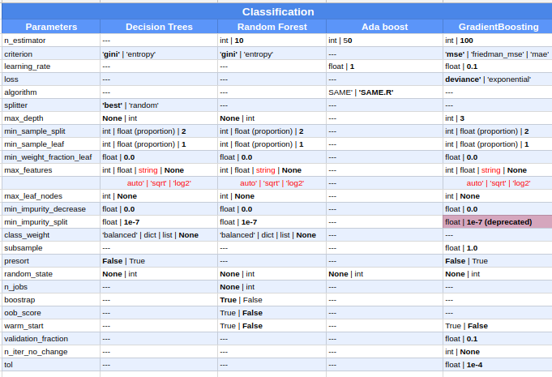
Hyperparameters

Slide 14
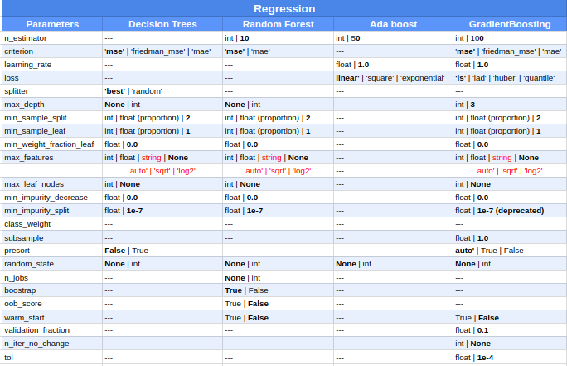
Hyperparameters

Slide 15
Hyperparameter Fine-Tuning
How to run Hyper-Parameters
Grid Search
Random Search

